Slide 1
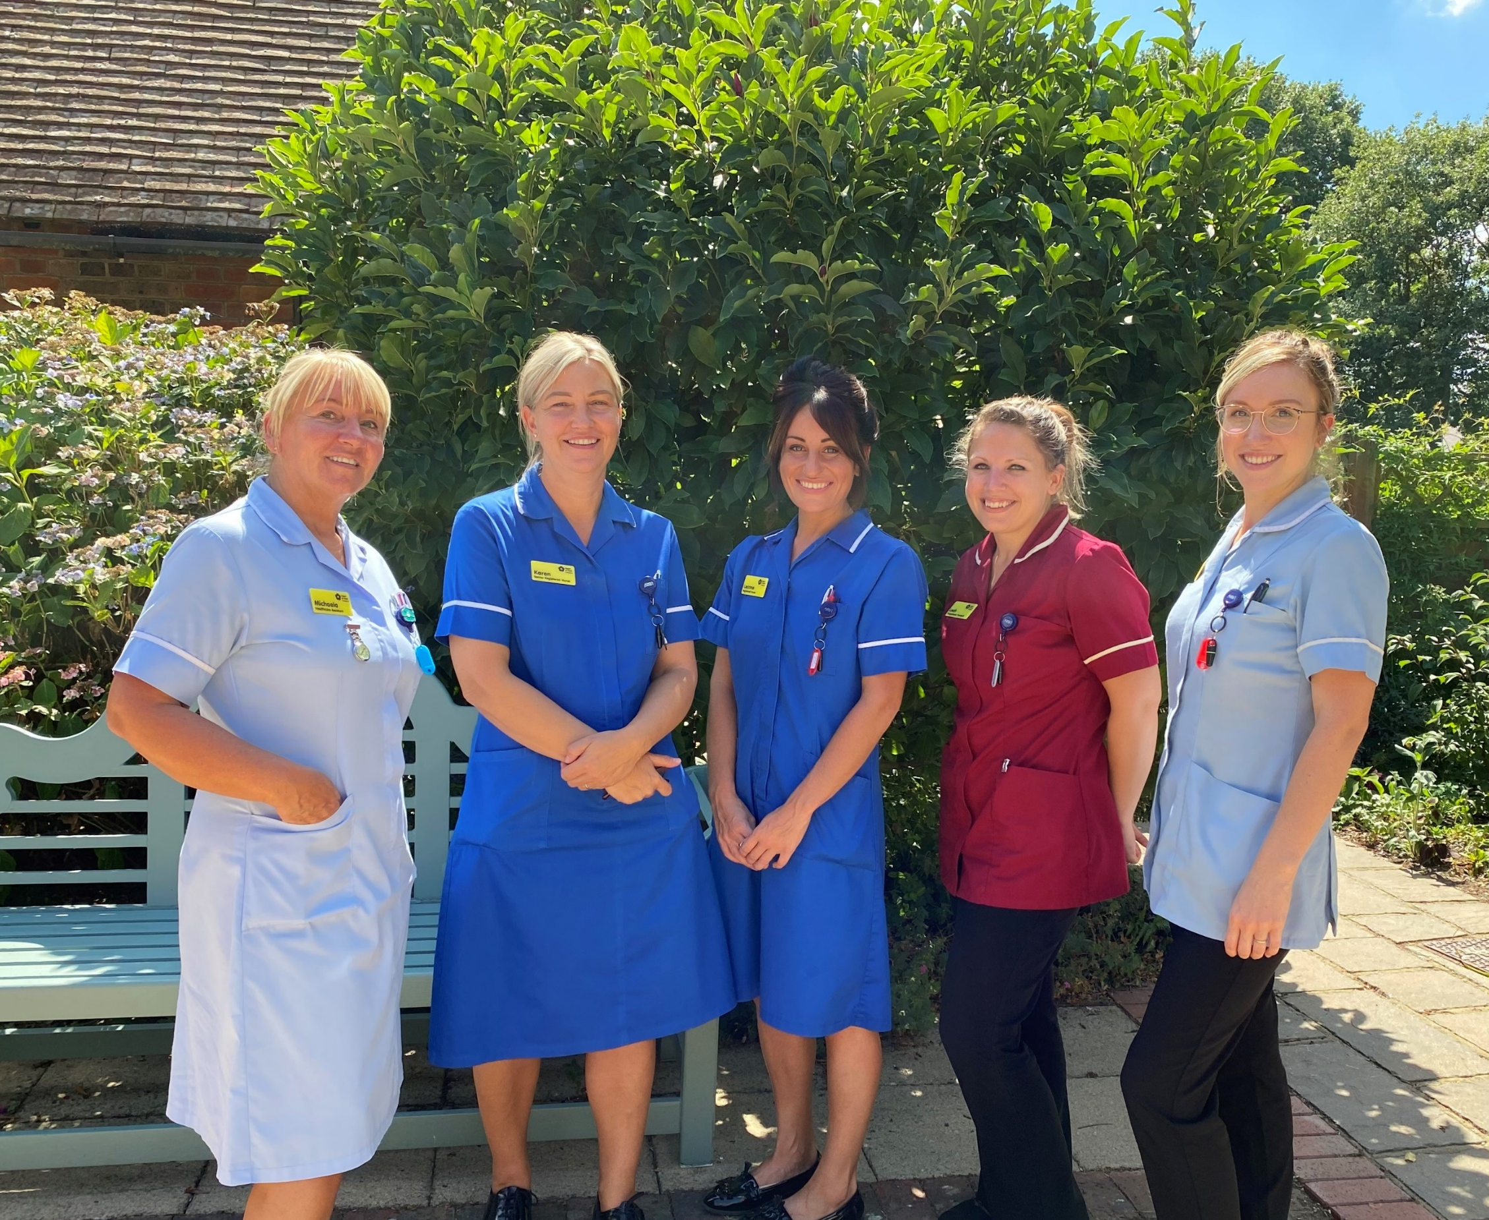

Corneal Donation within Hospice Inpatient Unit
Julie Lucas – Senior Staff Nurse

Slide 2

Background
More than two million people are estimated to be living with sight loss in the UK.
By 2050 the number is predicted to be double to over four million.¹
In 2022-2023, 4,719* corneas were donated to NHS Blood and Transplant.
“At the end of March 2023, 81% of registrants, where the information was available, indicated a willingness to donate all organs and tissue. However, of those who were not willing to donate all organs, the majority (63%) did not wish to donate their corneas.”²
*not all corneas donated or transplanted in the UK are reported to NHSBT and thus the donation data reported are not the full national data.
¹ Royal National Institute of Blind (2021). Key statistics about sight loss.
² NHS Blood and Transplant (2023). Organ and tissue donation and transplantation activity report 2022/23.

Slide 3

Barriers to Donations
Patient’s perspective
Healthcare professional’s perspective
Assume that they would be ineligible
Corneal donation not routinely discussed
Information not provided
Confidence and experience
Fear of upsetting patients and families
Not clear about when this option should be raised
Concern about enucleation
Not part of hospice culture
Family not wanting to consent despite the patient’s wish
Family not aware of
the patient’s wish
Retrieval team unable to
facilitate retrieval within
the time frame
Missing the referral window

Slide 4
Eligibility
Does the patient suffer from any of the following conditions?
Parkinson's Disease
Motor Neurone Disease
Alzheimer's Disease
Prion Diseases
Lymphoma, Myeloma, Leukaemia
Malignant metastatic melanoma
Multiple Sclerosis
Seropositivity to HIV, HBV, HCV, HTLV or Syphilis
Previous organ or tissue recipient
Idiopathic diseases (e.g. pulmonary fibrosis)
Laser eye surgery
This is not an exhaustive list.
If yes
The patient cannot be a donor

Slide 5
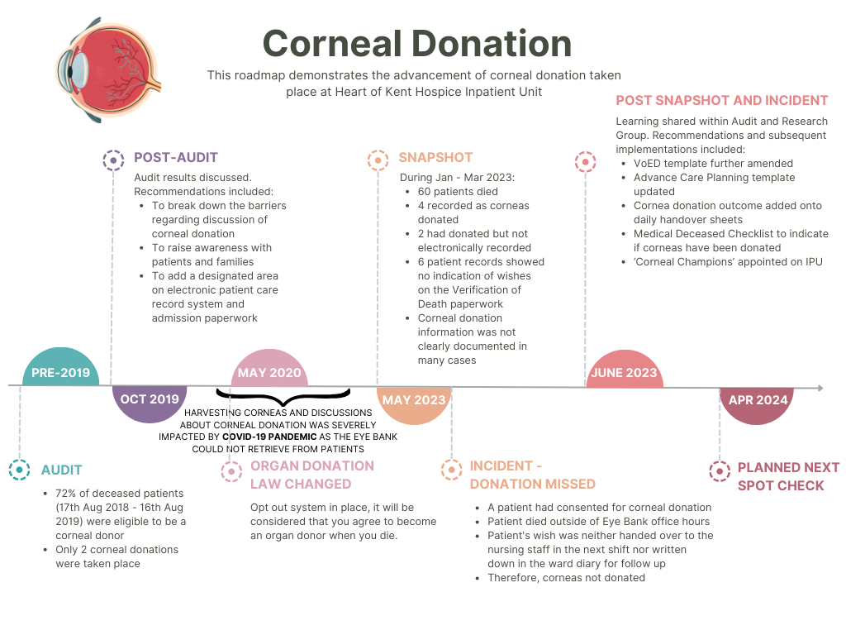
Our Journey

Slide 6
Our Journey
11 donations for year 2022/2023 and 20 donations until end of January for 2023/2024.

Slide 7

Implications
Documentation
Training and Education
Awareness
Electronic VoED form
Electronic corneal donation specific recording form for use after death
Daily handover sheets
Weekly MDT discussion
Weekly audit of the completion of ACP
Opportunities to witness corneal retrieval
Clinical team members’ induction
Raising the awareness and sharing the success at
staff, management and board levels
regional meetings
Eye donation leaflet in admission pack
Organ donation discussion at admission
Shared the timeline of advancements and learnings with local Eye Bank

Slide 8

Implications
Challenges
Rotation of Medical Trainees
Require a core group of staff to be champions
Awareness of enucleation
Plans
A link nurse to encourage corneal donation discussion taking place within the Hospice Community Team
Promoting the success to the public
Arranging bite-sized learning sessions with local Eye Bank
On-going monitoring through spot checks and audit
We will always endeavour to fulfill patient’s wishes.
.

Slide 9
References
Long-Sutehall, T., Zatorska, A., Myall, M. et al. (2023). Eye donation in hospice and hospital palliative care settings: perceptions, practice, and service development needs – findings from a national survey. BMC Palliat Care, 22(173). https://doi.org/10.1186/s12904-023-01300-7
NHS Blood and Transplant. (2021, October 14). Cornea recipient Shelley thanks her donor family for making an “incredible difference” to her life. Available from: https://www.nhsbt.nhs.uk/news/world-sight-day-2021/#:~:text=This%20World%20Sight%20Day%20(14,registering%20as%20an%20organ%20donor. Last accessed on 23rd Jan 2024.
NHS Blood and Transplant. Organ and tissue donation and transplantation activity report 2022/23. Available from: https://nhsbtdbe.blob.core.windows.net/umbraco-assets-corp/30188/activity-report-2022-2023-final.pdf. Last accessed on 23rd Jan 2024.
NHS Queen Victoria Hospital. Most people can be an eye donor. Available from: https://www.qvh.nhs.uk/wp-content/uploads/2018/03/Most-people-can-be-a-donor-information-flowchart.pdf. Last accessed on 23rd Jan 2024.
Royal National Institute of Blind. Key statistics about sight loss. Available from: https://media.rnib.org.uk/documents/Key_stats_about_sight_loss_2021.pdf. Last accessed on 23rd Jan 2024.
Sharkey, E., Walding, J., Evans, L., Seaman, S. (2023). Having vision: The role of quality improvement in sustaining rates of corneal donation in a hospice, and the impact of this through the COVID pandemic. Future Healthc J, 10(1), 59-62. https://doi.org/10.7861/fhj.2022-0123
Toro, M., Choragiewicz, T., Posarelli, C., Figus, M., Rejdak, R. and on behalf of European COVID-19 Cataract Group (#EUROCOVCAT). (2020). Early Impact of COVID-19 Outbreak on the Availability of Cornea Donors: Warnings and Recommendations. Clin Ophthalmol,14, 2879-2882. https://doi.org/10.2147/OPTH.S260960
Walker, L., Neoh, K., Gilkes, H., Rayment, C. (2018). A qualitative study using semi-structured interviews of palliative care patients’ views on corneal donation and the timing of its discussion. Palliative Medicine, 32(8), 1428-1437. https://doi.org/10.1177/0269216318784210
Information strip panel

Slide 10

Thank You & Questions
Thank you

